Slide 1
Reflections on Project Management
A collection of thoughts and experience from the eyes of Industry…
George Corbin
Solvay Specialty Polymers
April 9, 2015

Slide 2
What is a “Project”
The Taxonomy of a project:
A unique effort
With a defined beginning and a defined end, with
With defined resources
To produce specific deliverables
Not ongoing “Operations”
Projects Differ in Many Important Ways:
Nature - Construction, Research, Process Improvement, Social Program, etc
Scope - Size & Stability
Governance
Risks / Uncertainties
Complexity
Drivers: Cost, Schedule, Performance, HSE
Planning Approach & Granularity
etc.
“My personal philosophy is not to undertake a project unless it is manifestly important and nearly impossible.” ~ Edwin Land

Slide 3
Project Management & Leadership
Project Management:
A structured approach that improves the likelihood that a series of complex tasks (some parallel and some sequential) will deliver the project outcomes and minimize the failure
The means (e.g. tools, techniques, methods, and knowledge) to accomplish the goal effectively within the agreed upon time frame
Project Management Institute (PMI) as a Reference
Key “Hard” Competencies: Planning, Organizing, & Controlling
Project Leadership:
The process of influencing (often without direct authority) to accomplish the goal effectively within the agreed upon time frame.
Key “Soft” Competencies: Setting Direction, Aligning Resources, Arbitrating, Motivating, Communicating

Slide 4
Insights from Scott Adams…
What % of Projects are considered “Successes” by Sponsors?
Lessons in Project Failures…
Dilbert's Advice

Slide 5
Project Management – Cheat Sheet
Why Work on this Project?
Strategic? Is it Real? Can we Win? Is it Worth it?
Understand Organizational (& Personal!) Incentives - May need to Reshape Project
Kill Zombie Projects Here (based on misinformation, emotion, exuberance, politics, etc)
What is the Definition of “Success”
Need to Ensure specificity (“SMART”) & that there is only one definition!
Deliverables, Schedule, Cost, Financial Return, HSE
Who is the Project Sponsor / Investor?
Incentives? Assumptions? Expectations? Communication Needs?
Which Skills are needed on the Project Team?
Availability (Full/Part Time)? Incentives? Commitment?
What are the Key Project Assumptions & Constraints?
Technical Risk, Market Risk , Regulatory, Supply Chain, Currency, Intellectual Property, etc
How will we Implement this Project?
Plan-the-Work, Work-the-Plan, & Expect-the-Unexpected (“flexible discipline”)
Deterministic vs Probabilistic – different methodologies…
Risks & Risk Management Strategy?
Decision Making Protocols? (Change Management)
Communications within Team & with Key Stakeholders (focus on Variances)
How will we manage Interpersonal Matters (“Soft” Stuff”)?
Accountability? Capabilities? Availability? Conflict Management?
Recognize & Reward Success? (Team and Individual)

Slide 6
GSAG Questions
What are good project management skills to have?
What would having good project management skills look like?
How can we as students (especially graduate students) cultivate those skills while we are in school?
What might be some good ways to market those skills to potential employers as we look for jobs?
“The secret of Science is to ask the right question, and it is the choice of problem more than anything else that marks the man of genius in the scientific world.” ~ Henry Tizard

Slide 7
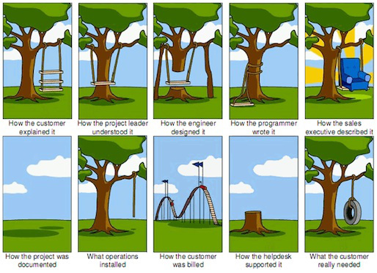
Discussion: As a project leader, how would you prevent a scenario like this from happening to your own project?
Communication

