Slide 1
Dissertation Proposal
What you need to know before, during, and after

Slide 2
What is a dissertation proposal?
An important first step towards writing your final dissertation on a taught or research masters course, or a PhD level course.
Needs to be unique – must give promise of being a genuine addition to the fundamental knowledge in the field or a new and better interpretation of facts already known.
Sets the stage for your research
Should help you make a clear plan for your final project – a table of contents for your research
Will help you explain what it is you intend to examine and how you plan to collect and analyze your data
Does not have to be planned out exactly, as your topic might change a little during the course of your research

Slide 3
When do I need to propose?
According to the MSE Graduate Student Handbook, the “dissertation proposal defense must be held within 12 months after the student has passed the Ph.D. Comprehensive Exam.”
Note: All coursework, with the exception of the minor coursework, must be complete or in progress (IP) before you propose.
Written notice of this oral presentation clearly stating topic, time, date and place MUST be given to the School populace at least 2 weeks before the presentation.

Slide 4
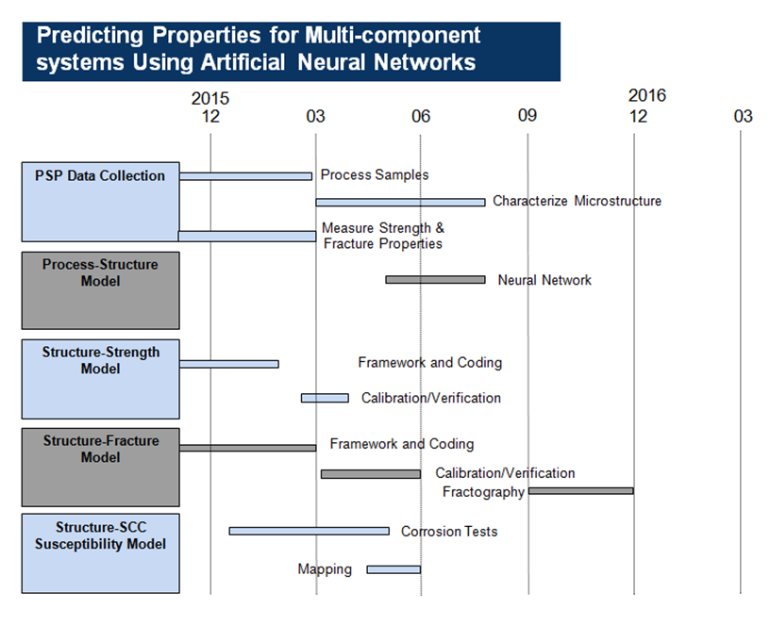
What should the dissertation proposal include?
Executive summary clearly identifying the topic and the need of the research
A critical analysis of the related literature including current state of the art
Description of the overall objectives of the proposed research
Discussion of the theoretical, fundamental and/or experimental approaches to be used to achieve the objectives
Preliminary results and discussion
Detailed project work plan/timeline for completion e.g. Gantt chart

Slide 5
How long should the dissertation proposal be?
The recommended length of this proposal document should be not exceed 20 pages of text (assuming a minimum 11 pt. font, single line spacing, and 2.5 cm margins) i.e. an approximate maximum of 12000 words. Tables, figures and references would not be counted in this page/word limit.

Slide 6
Who reviews the dissertation proposal?
There are 2 committees which function to advise, approve and conduct the final doctoral oral examination of the thesis and the student's knowledge of the field in which it lies.
Thesis Advisory Committee or the Thesis Reading Committee
Consists of at least three persons, one of whom is the Thesis Advisor.
Approves the research topic, provides advice and guidance during the research and is charged with approving the thesis when the research is completed and presented as the doctoral thesis. When the Thesis Advisory Committee considers the thesis to be satisfactory, a recommendation is made to the Vice Provost for Graduate Education and Faculty Affairs for the appointment of the second committee.
Final Doctoral Examination Committee
Consists of at least five individuals.
Always contains the Thesis Advisory Committee members and others as appropriate.

Slide 7
Who makes up the thesis advisory committee?
The Thesis Advisory Committee consists of at least 3 members satisfying the following:
the thesis advisor shall be a member of the Academic Faculty (with approval of the school or college Graduate Committee, an adjunct* faculty member appointed for the specific purpose of advising graduate students may serve as the thesis advisor);
the majority of committee members shall be members of the Academic Faculty. The Committee is approved by the Graduate Committee of the School of College, recommended by the School Director through the College Dean, and appointed by the Vice Provost for Graduate Education and Faculty Affairs * - "adjunct" does not indicate formal appointment, but rather appointment as indicated in this policy statement.

Slide 8
Who makes up the final doctoral examination committee?
The Final Doctoral Examination Committee, which consists of at least 5 persons:
Always contains the Thesis Advisory Committee members and others as appropriate, who are recommended by the school or college to the Dean of the Graduate Division for approval.
At least one member must be from the academic faculty of a School (or College) which is distinct from the unit in which the student is enrolled.
It is recognized that some Schools and Colleges may wish to appoint a Thesis Advisory Committee which consists of 5 or more persons and to recommend this committee to serve as the Final Doctoral Examination Committee. Where the constraints outlined above are met for both committees, this is permissible. (http://www.grad.gatech.edu/admin/advise_policy.html)

Slide 9
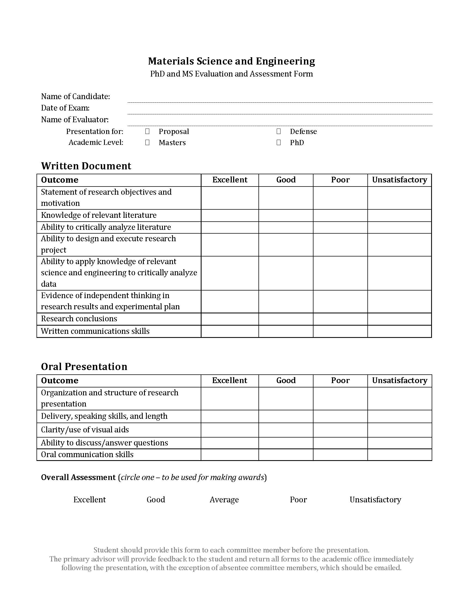
What is being evaluated by the committee?
The proposal defense will be evaluated by the committee, both on the written document and oral presentation using the ‘Proposal & Defense Committee Assessment Form’.

Slide 10
What’s next?
After the successful defense of the proposal, a completed Request for Admission to Ph.D. Candidacy form approved by the Final Doctoral Examination Committee must be submitted to the School Office for Graduate Studies & Research. This form is available on the GT Graduate Office website: http://www.grad.gatech.edu/thesis/forms.php.
After completing all course requirements, achieving a satisfactory scholastic record (at least 3.0 GPA), passing the Ph.D. Comprehensive Exam, defending the dissertation proposal, and receiving approval of the dissertation topic, the GT Office of Graduate Studies and Research will formally admit the student to candidacy for the Ph.D. degree.

Slide 11
Questions?

